Slide 1
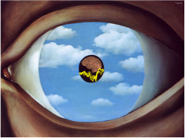
Our vision and and a little brain with optically pumped magnetometers
Sarang Dalal
Director, NEMOlab
Center of Functionally Integrative Neuroscience
sarang@cfin.au.dk cfin.au.dk/nemo

Slide 2
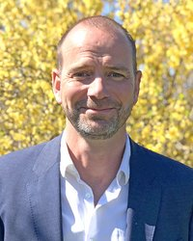
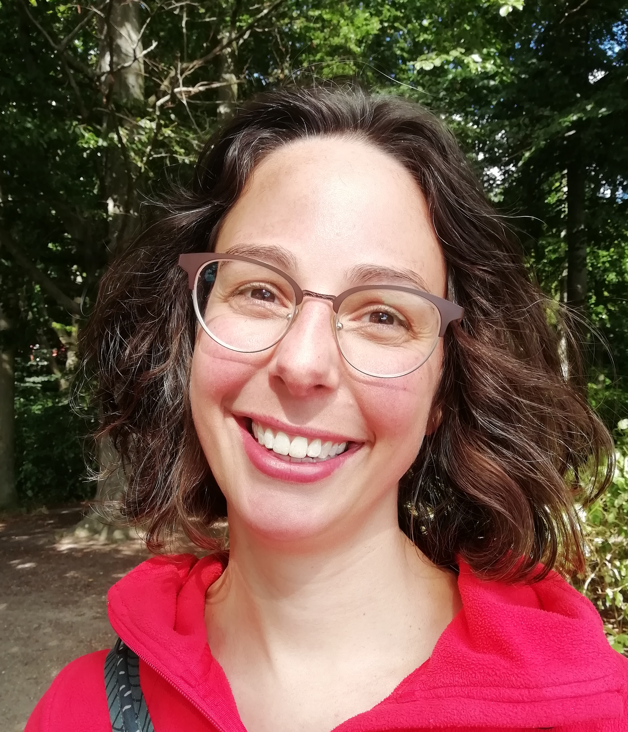
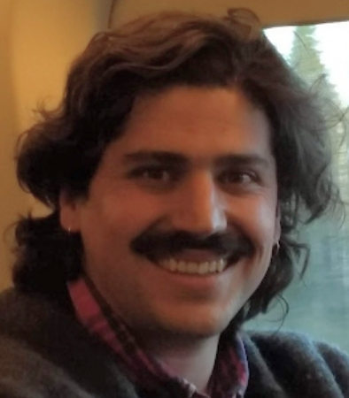
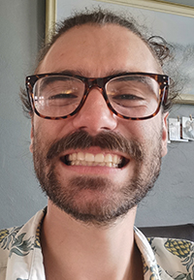

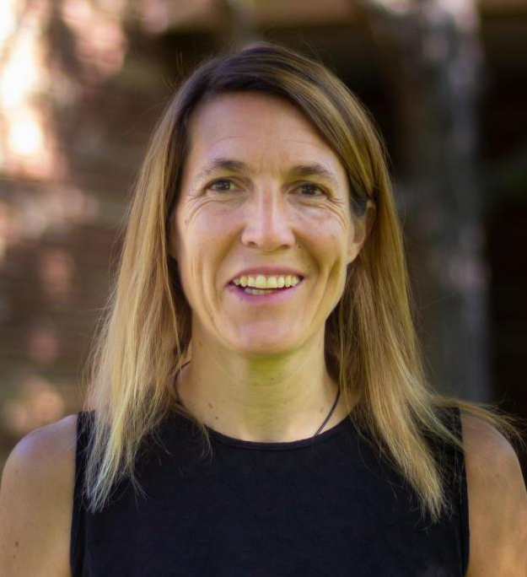
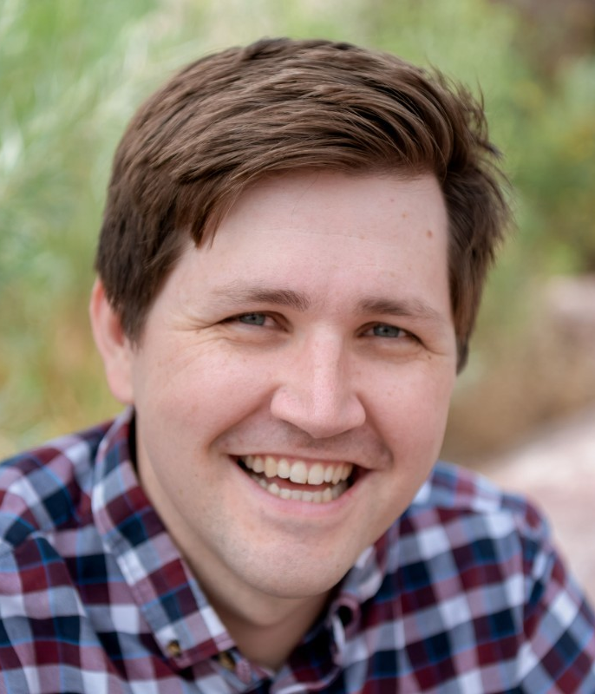
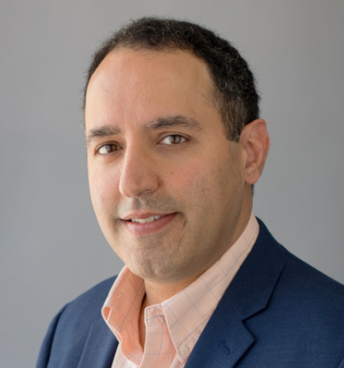
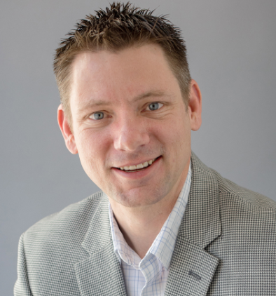

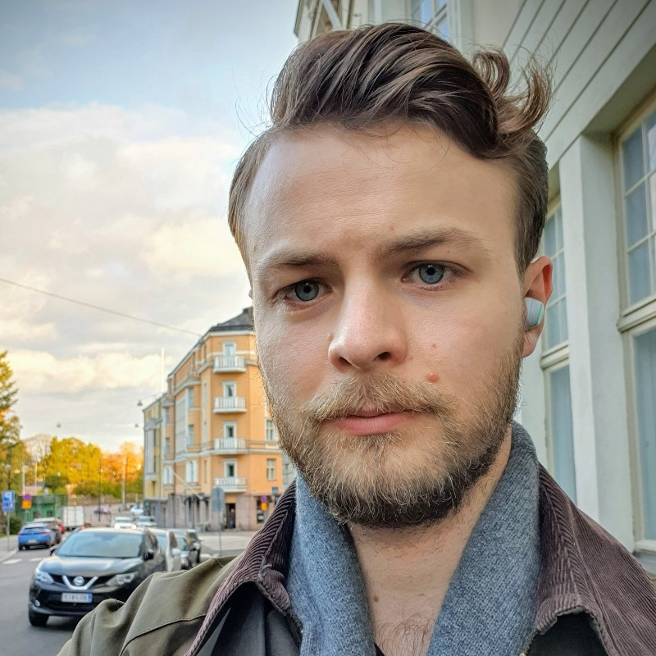

Opening Credits
Lars H. Pedersen
Obstetrics
Britta Westner
(now Donders Institute)
Jamie Lubell
CFIN-NEMOlab
Jacob Andersen
CFIN-NEMOlab
Svenja Knappe
Tyler Maydew
Orang Alem
Jeramy Hughes
Rasmus Zetter

Slide 3
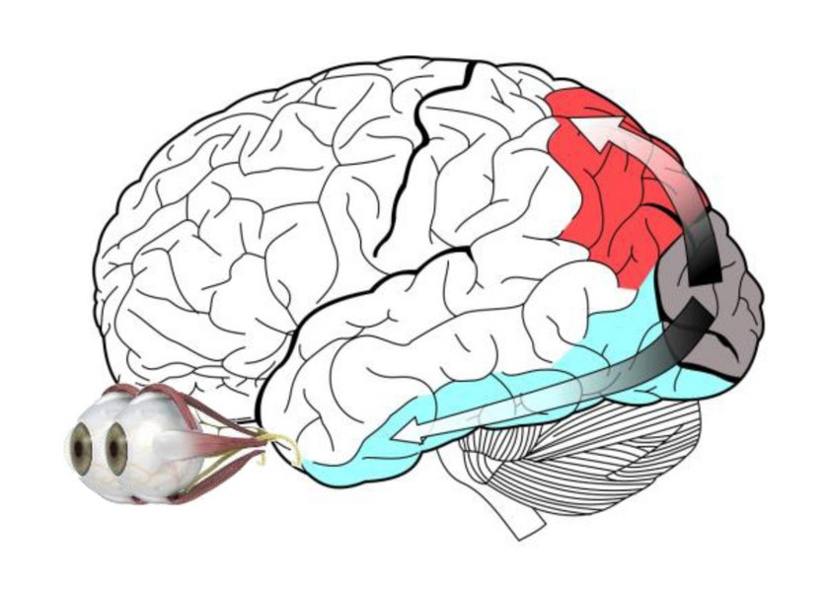
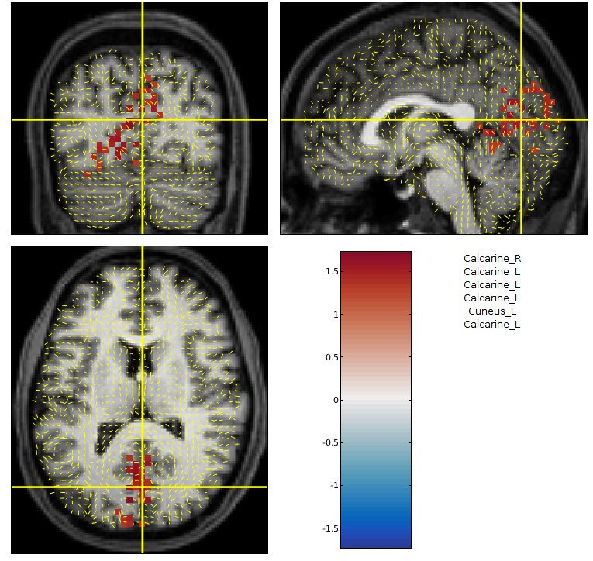
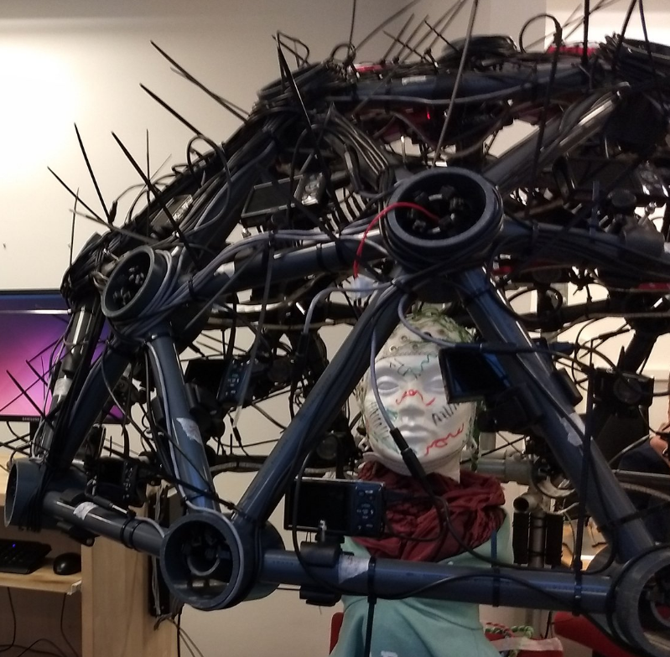
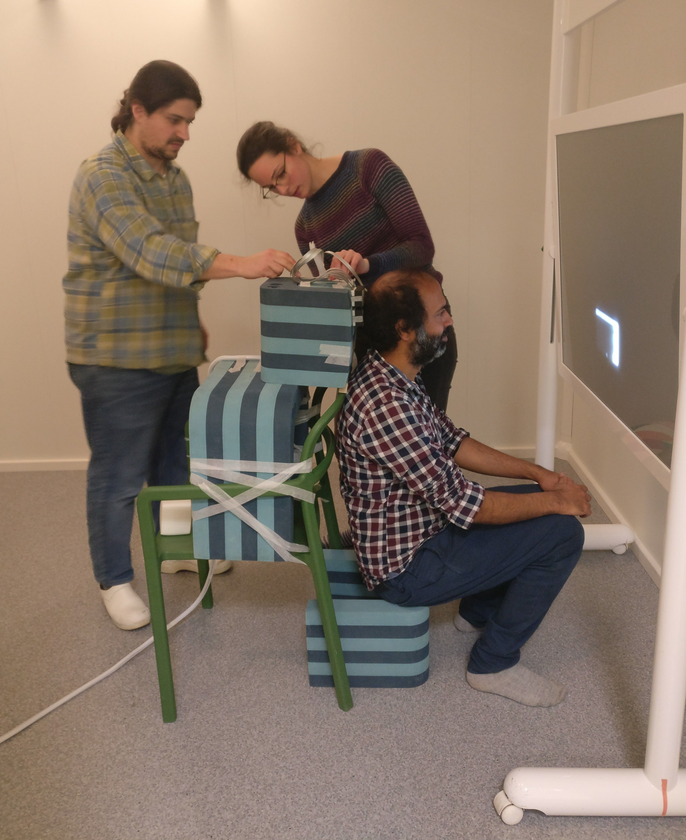
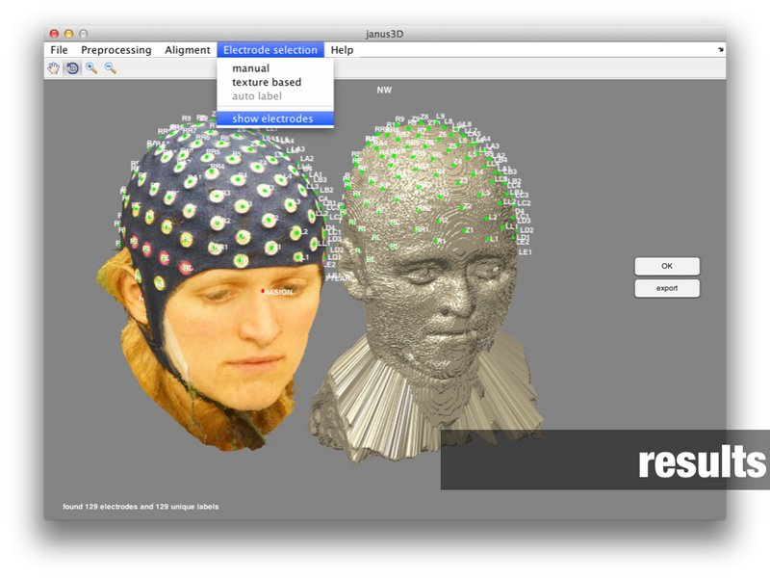
NEMOlab Overview
Neural oscillations involved in perception
MEG/EEG analysis methods
MEG/EEG acquisition methods

Slide 4
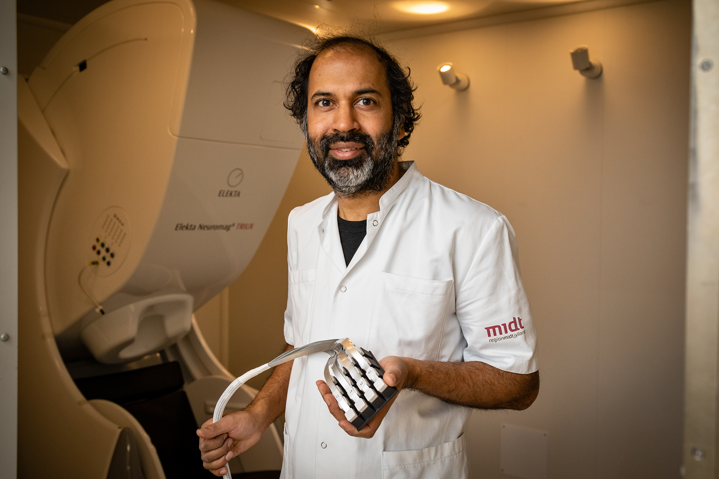
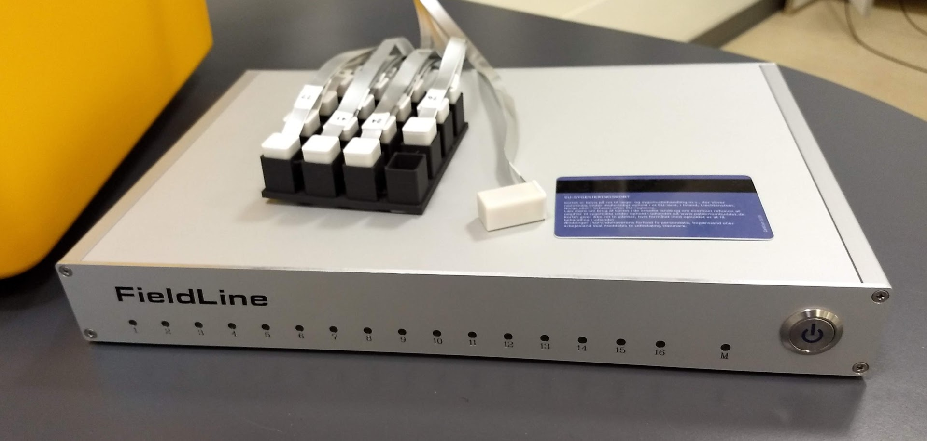
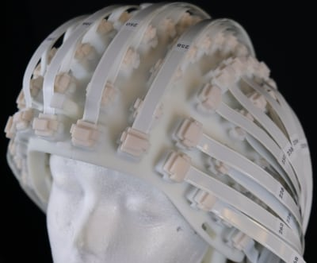

Optically Pumped Magnetometers (OPMs)
Optically pumped magnetometers are emerging as a competitive alternative to SQUIDs for measuring MEG
Small + room-temperature + lower cost + tolerance to movement →
any desired configuration directly on head or body
For me: well-suited for visual cortex, but also the retina

Slide 5
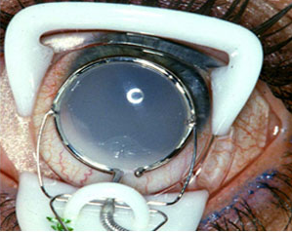
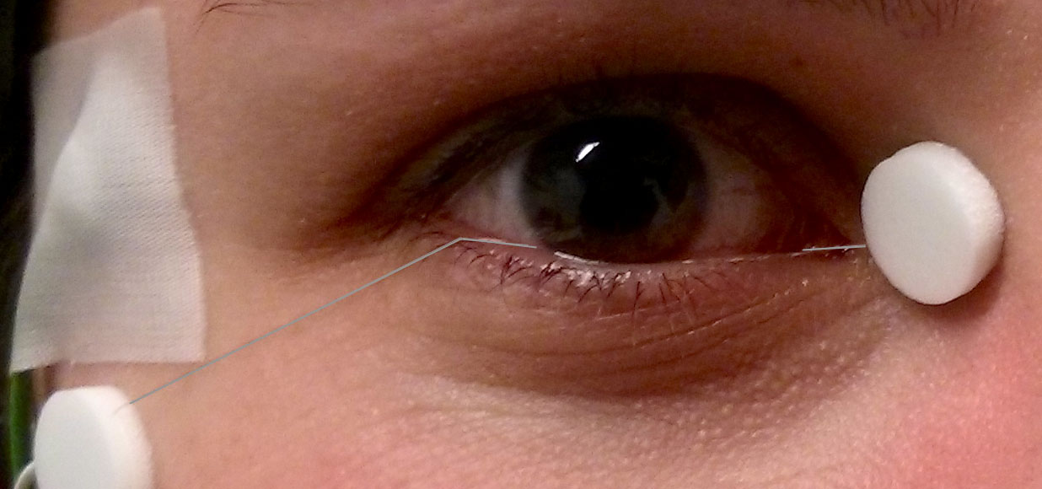
The Electroretinogram (ERG)
ERG is routine in eye clinics – but the ‘textbook’ electrode is not appropriate for healthy volunteers or many neuro patients
A relatively comfortable alternative:
the DTL fiber electrode
… but it’s still not for everyone

Slide 6
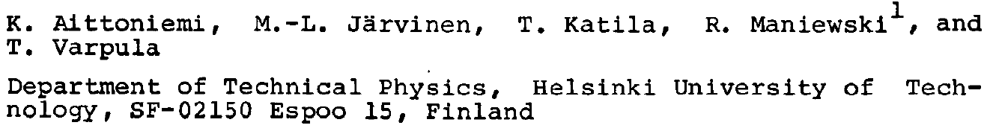
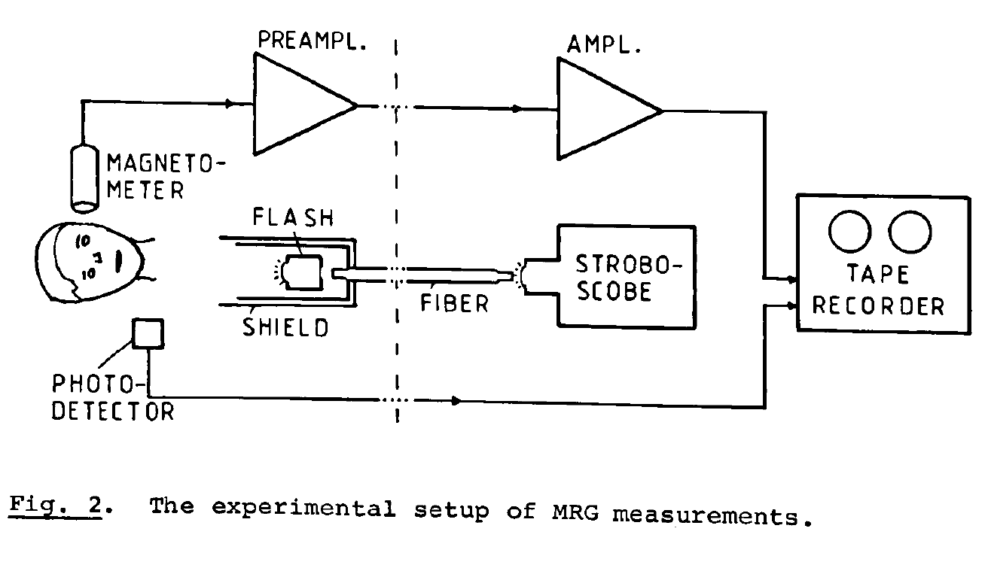
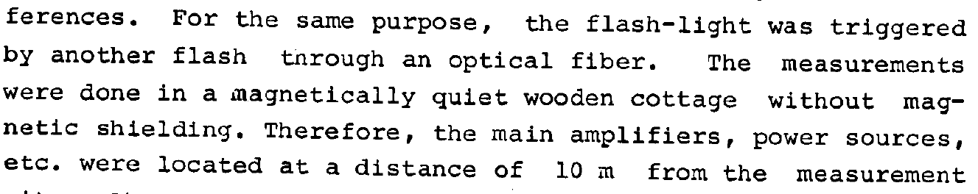
The Magnetoretinogram (MRG) with OPMs
(1980)

Slide 7
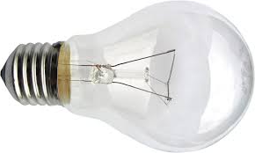
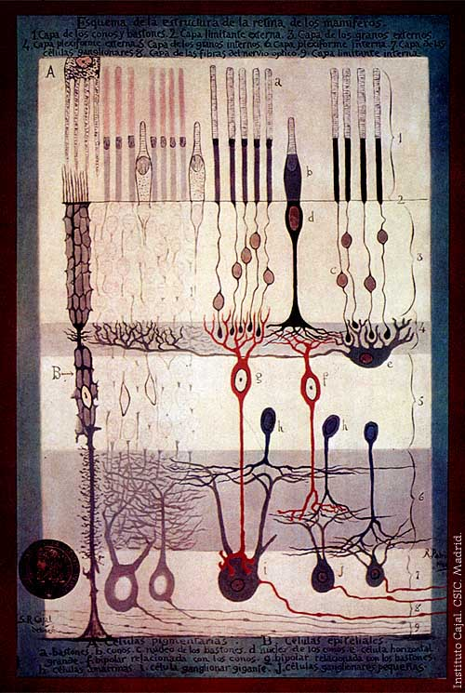
The Electroretinogram (ERG)
amacrine & ganglion cells – output to cortex
ERG high-frequency oscillation
Cross-section of Retina
bipolar cells
rods & cones
basic ERG waveform
light flash

Slide 8
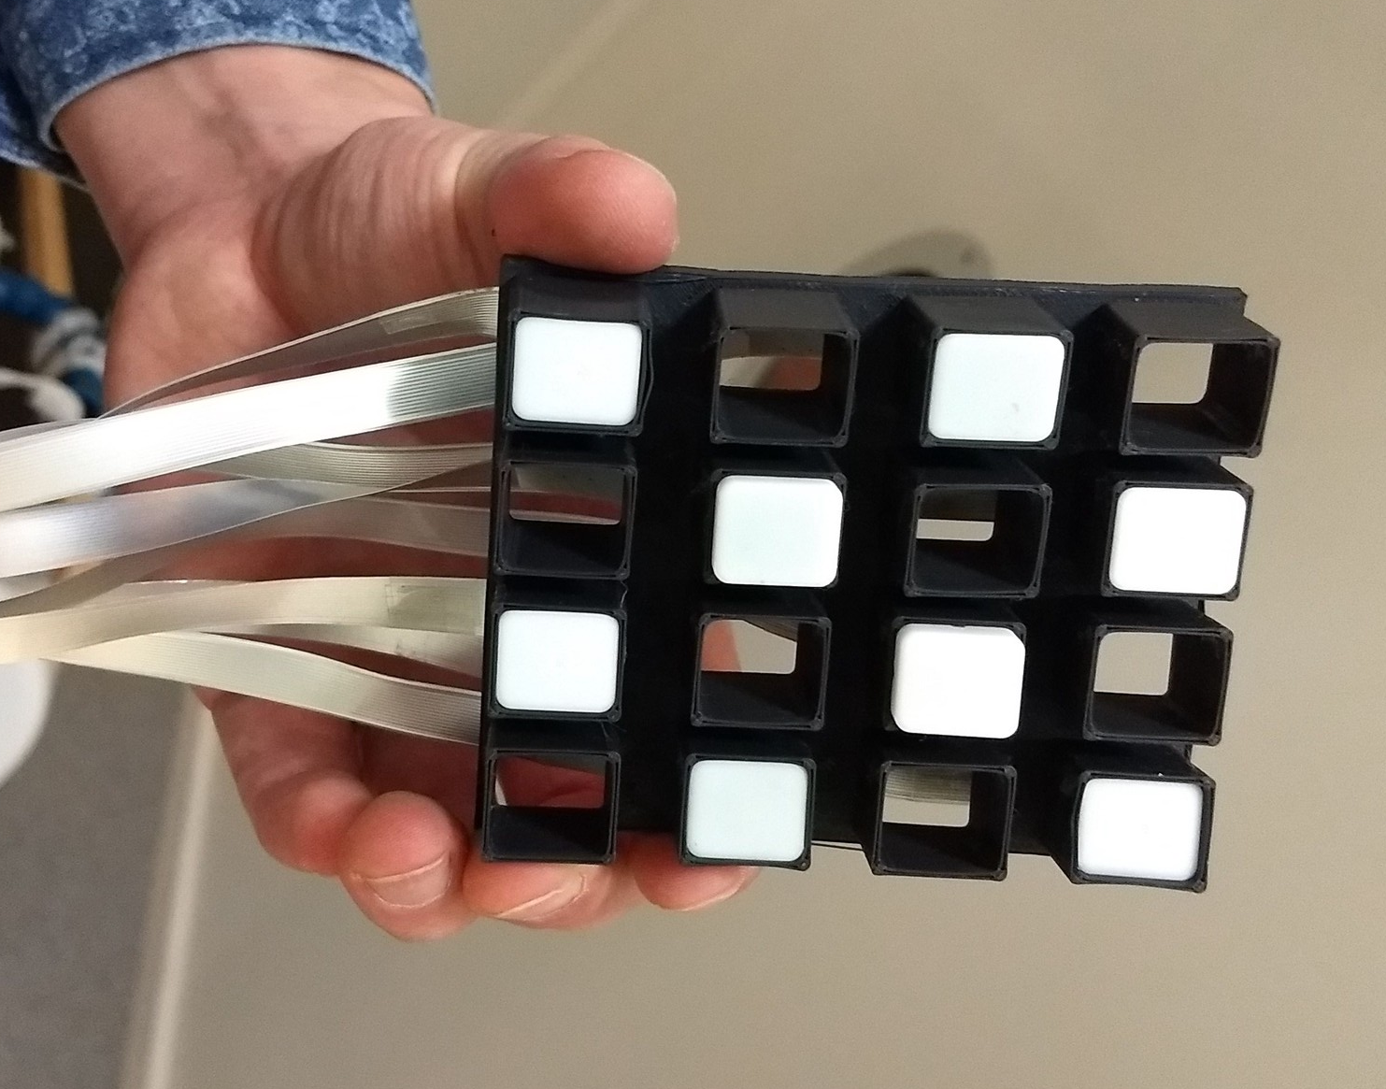
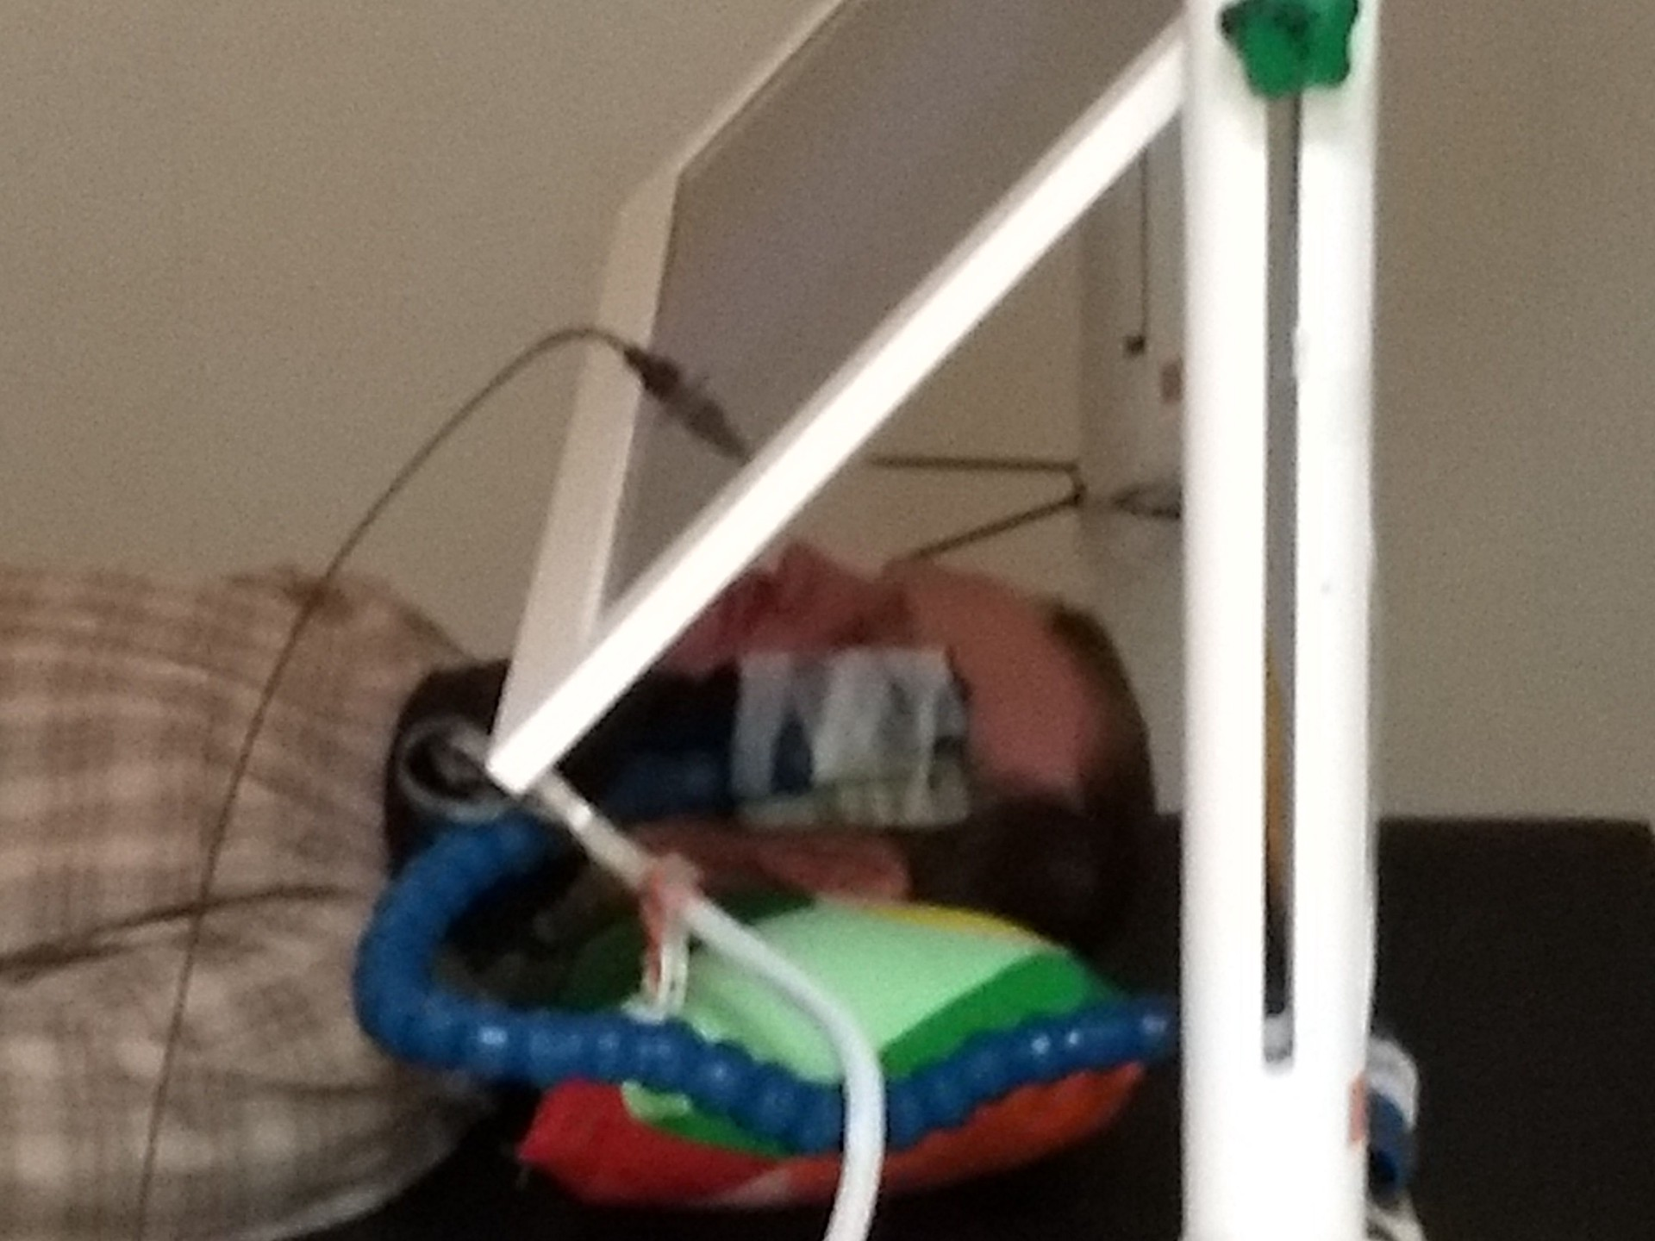
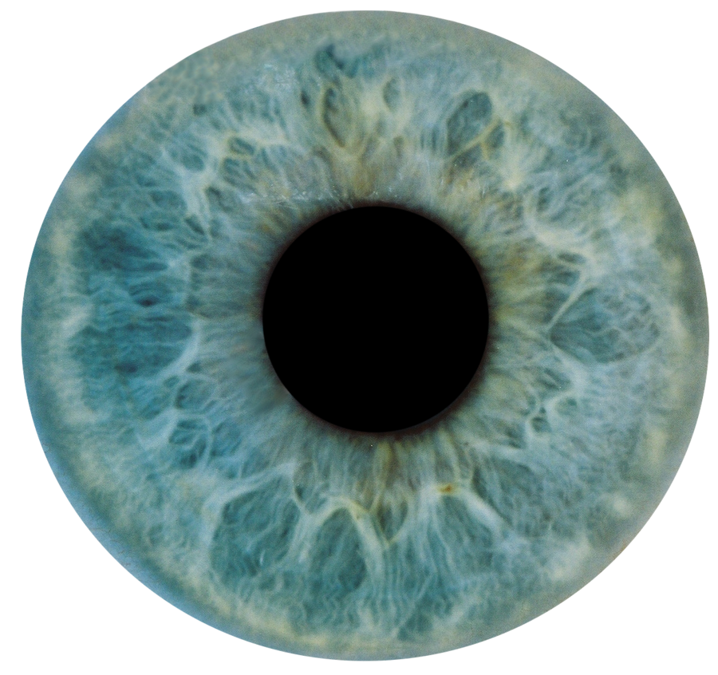
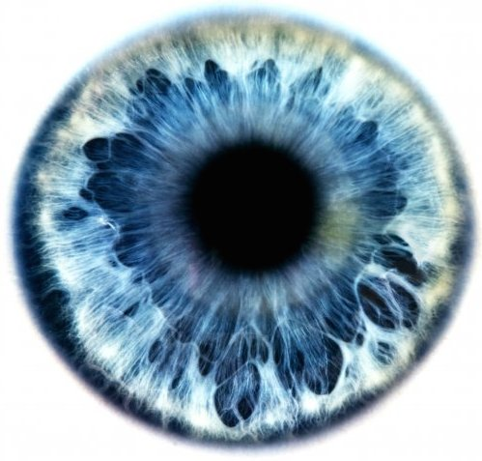
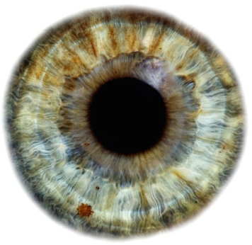
The Magnetoretinogram (MRG) with OPMs
1.5
MRG with OPMs
1
0.5
0
Field (pT)
-0.5
-1
a-wave
b-wave
-1.5
-0.1
0
0.1
0.2
0.3
evoked response from each of 8 participants
a-wave and b-wave detectable!
b-wave SNR:
~4 dB with OPM (contactless!)
~8 dB with ERG (on eye)
HFO more elusive...
100
Time (s)
80
60
40
20
0
Voltage (µV)
-20
-40
ERG
-60
-80
-0.1
0
0.1
0.2
0.3
Time (s)

Slide 9
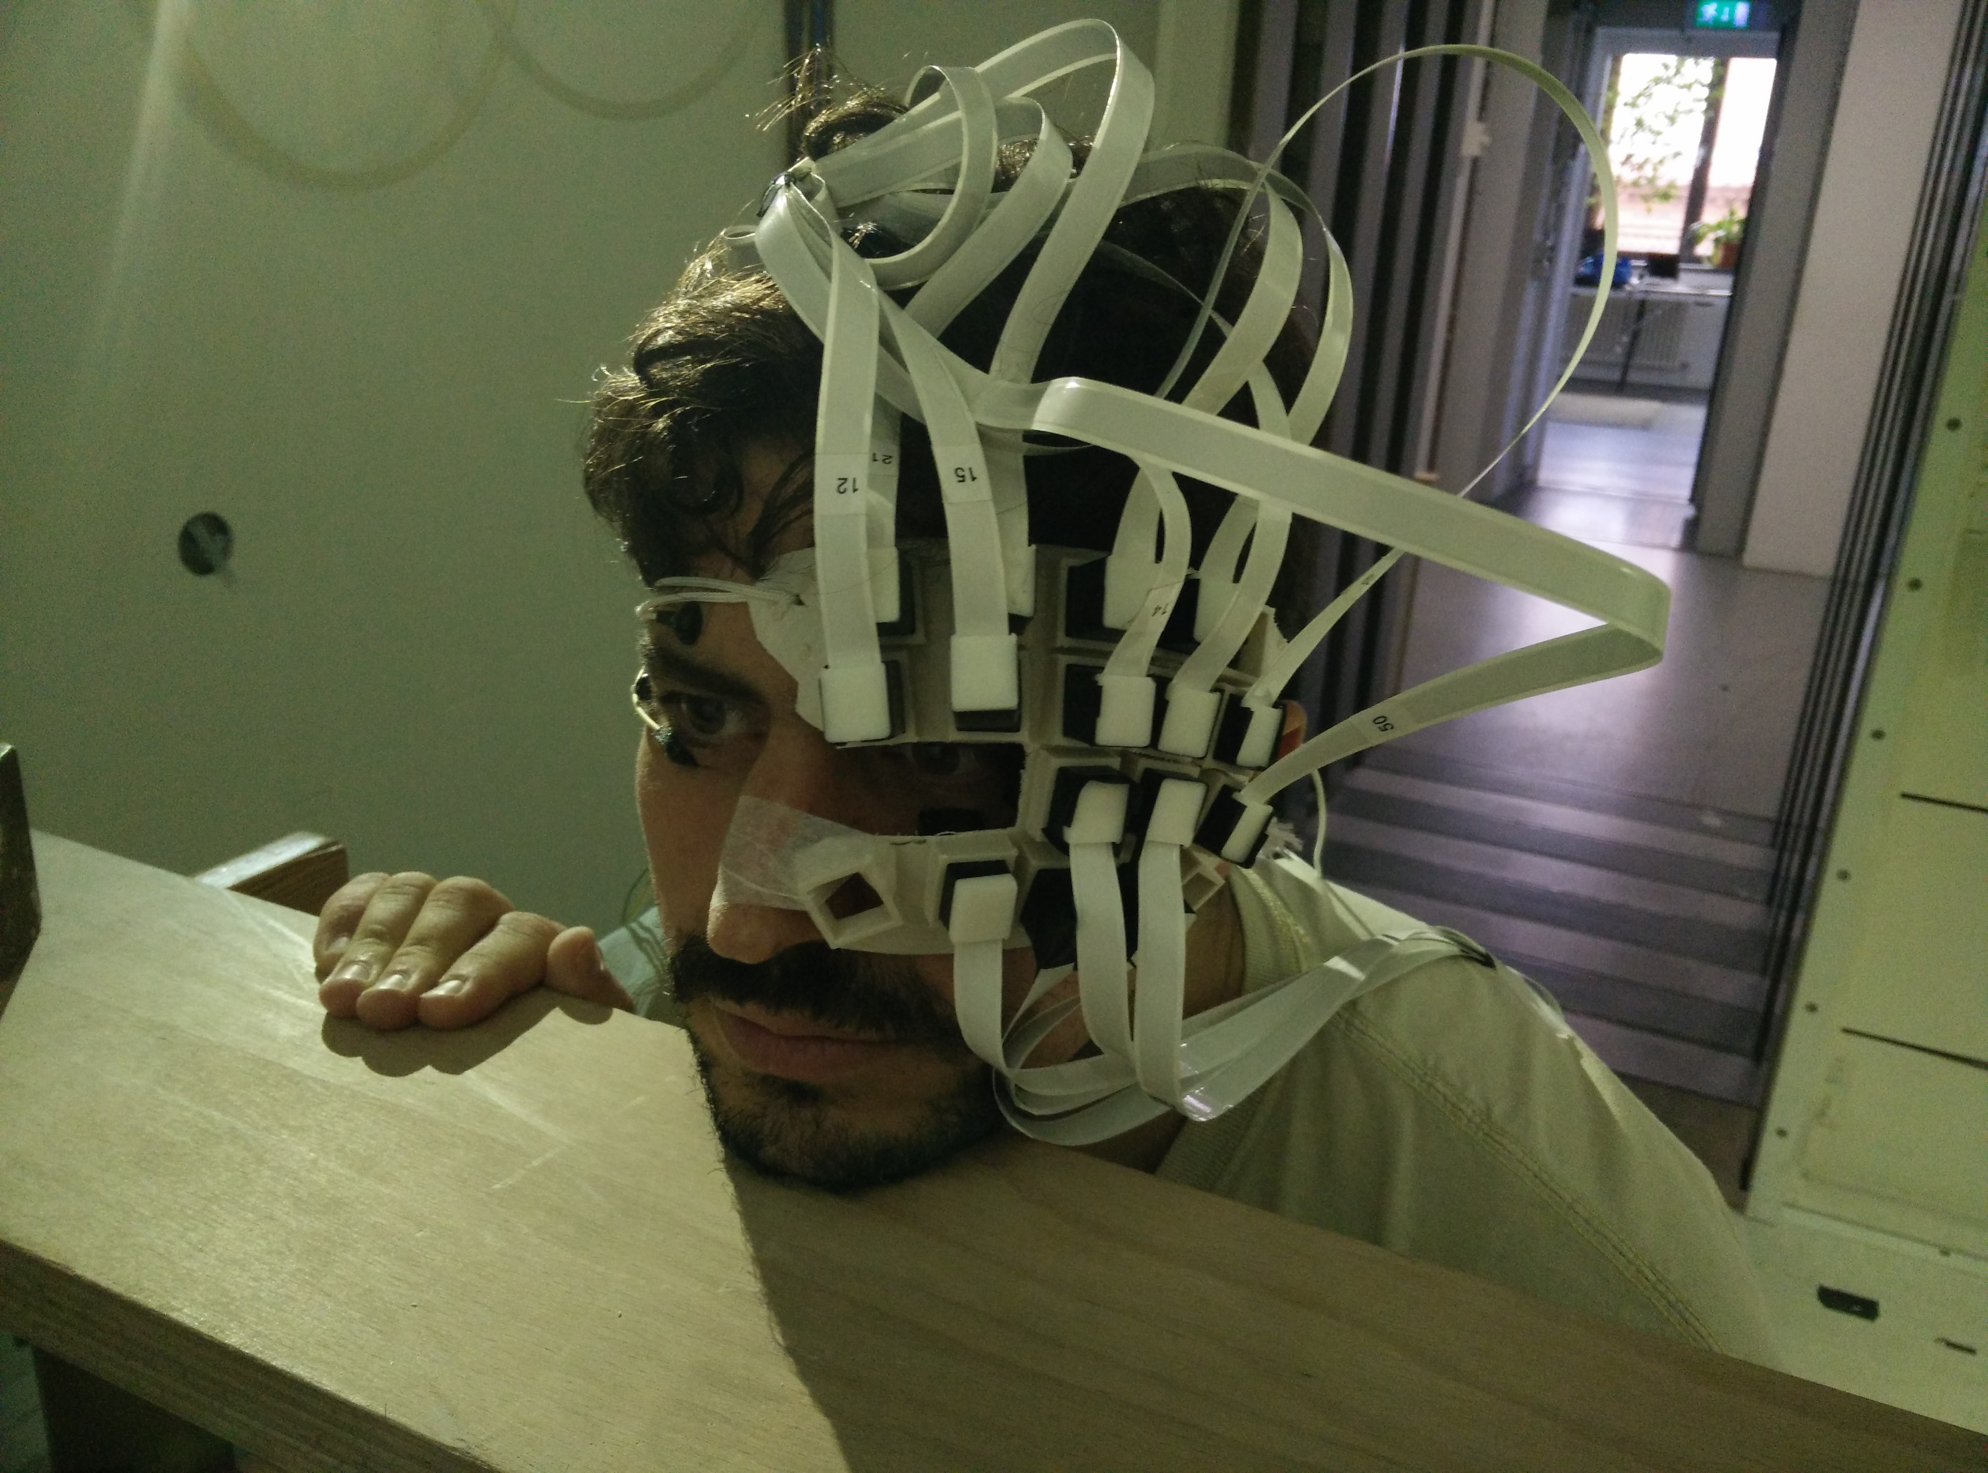
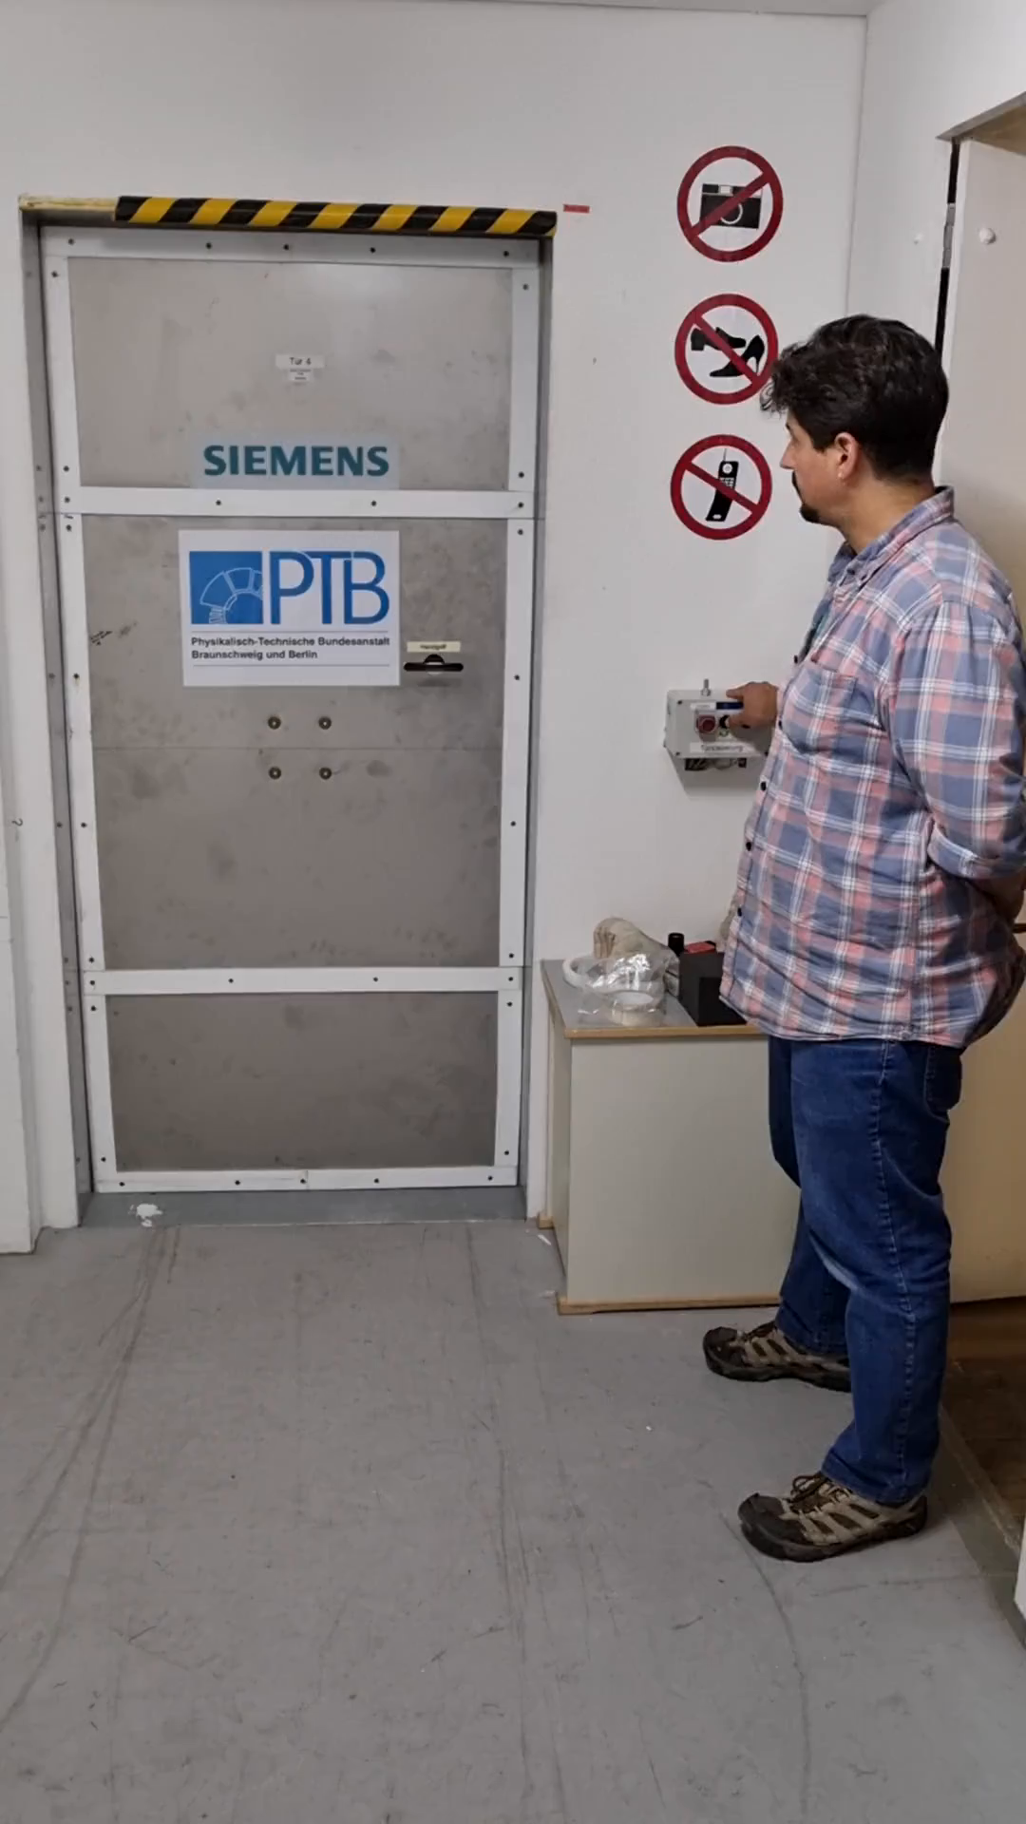
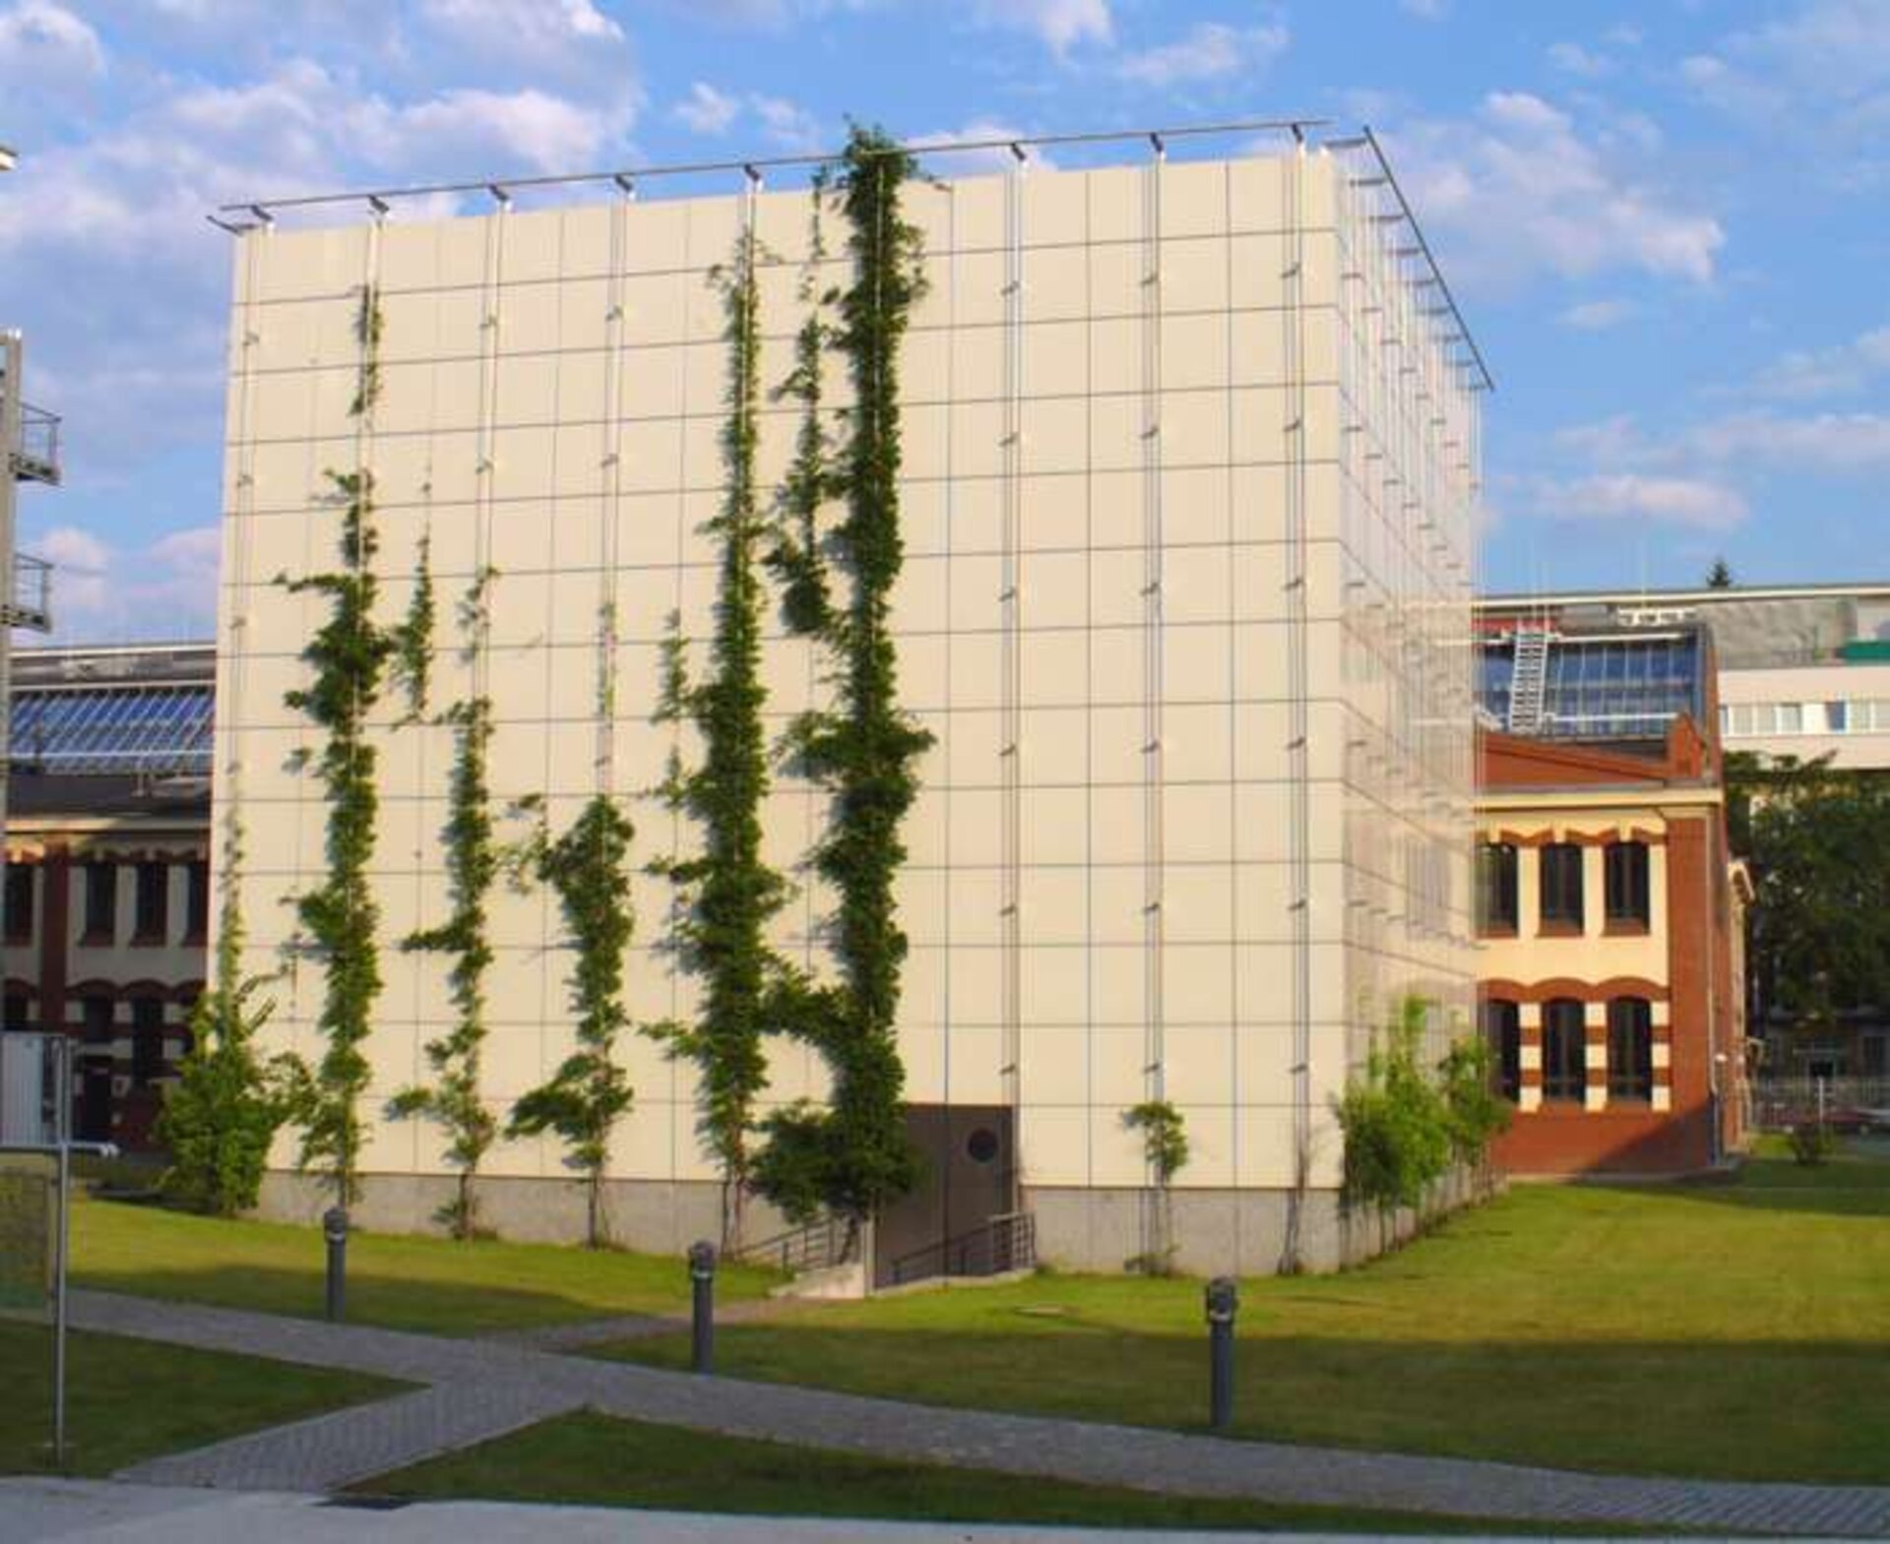
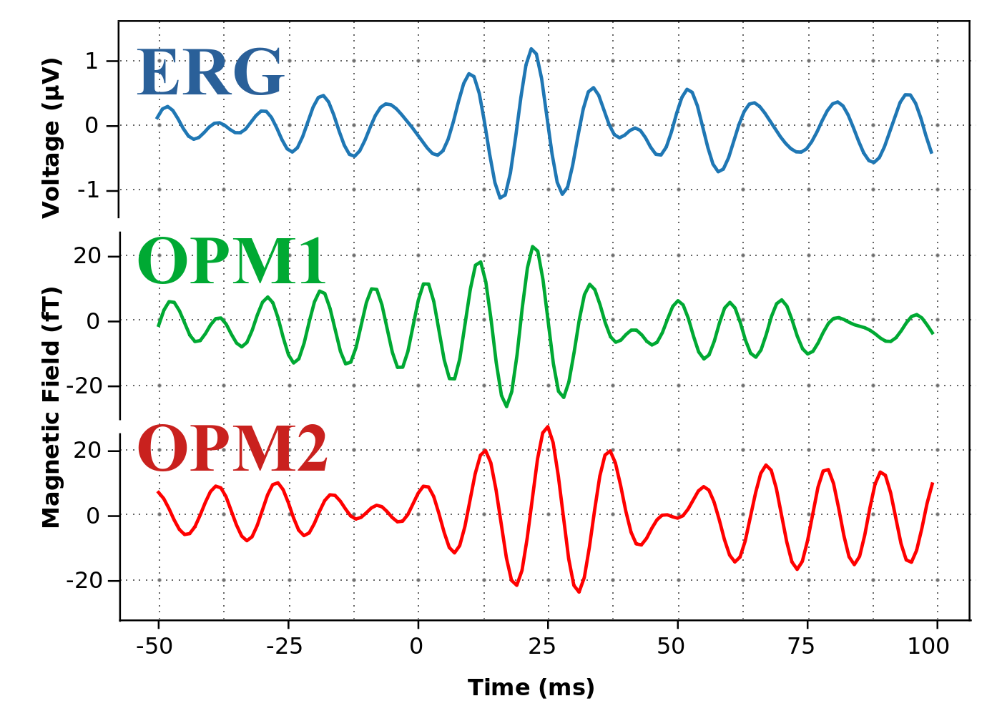
The Magnetoretinogram (MRG) with OPMs
Retinal high-frequency oscillations (~120 Hz)
Tilmann Sander-Thömmes
PTB Berlin

Slide 10
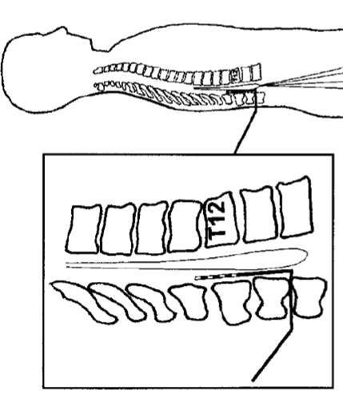
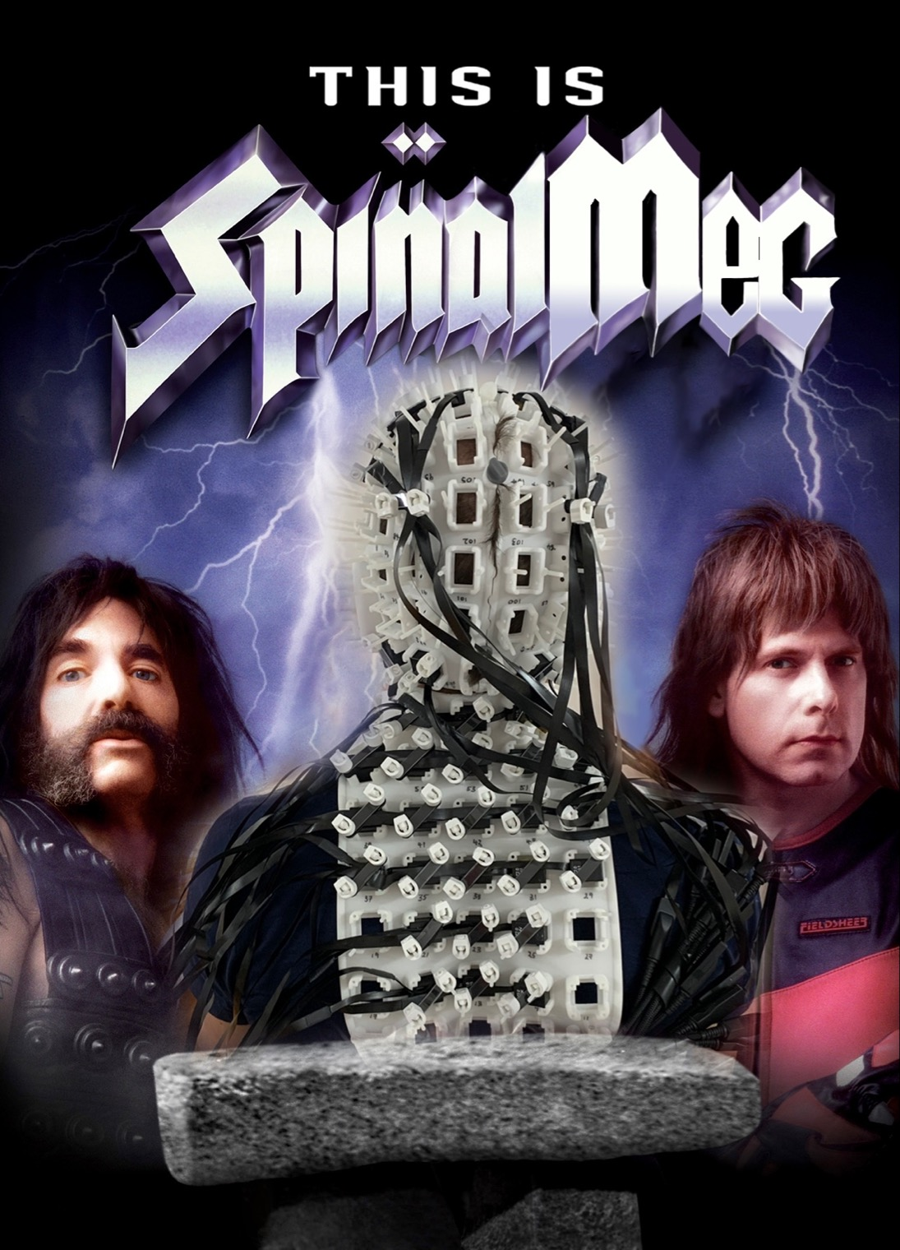

OPM Magnetospinography
Spinal cord monitoring useful in assessing neuropathies and traumatic injuries
Would be useful for research into pain and neurodegenerative disorders...
Electrical spinal cord responses require implanted electrodes – so mostly restricted to neurosurgical procedures
SQUIDs have been used to measure magnetic responses
Lydia Mardell et al. (UCL) demonstrated OPM-based magnetospinography
spinal cord evoked potentials

Slide 11
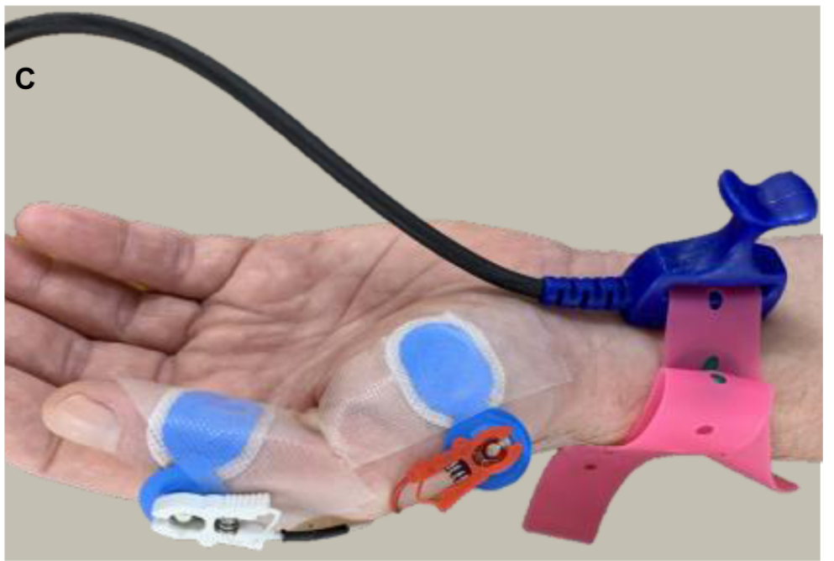
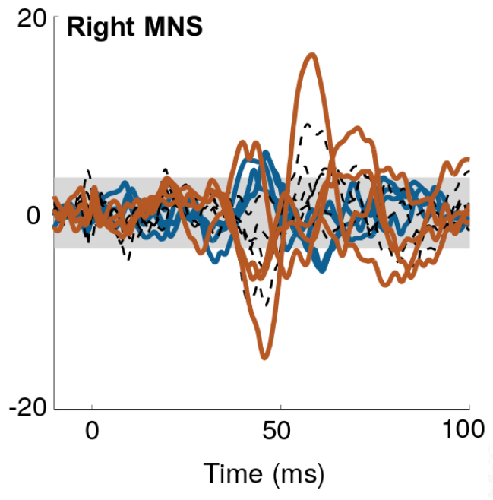
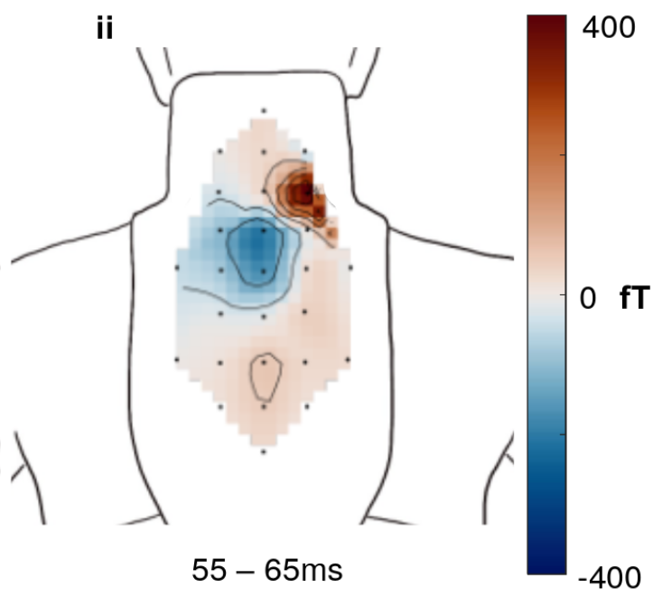
OPM Magnetospinography
Mardell et al. 2022 bioRxiv
median nerve stimulation
(i.e. shocks to the wrist)

Slide 12
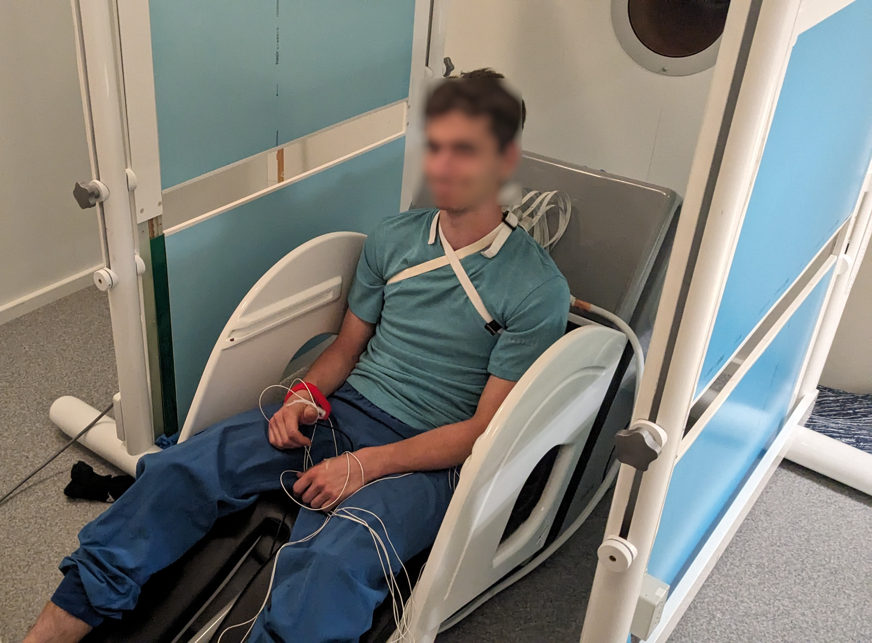
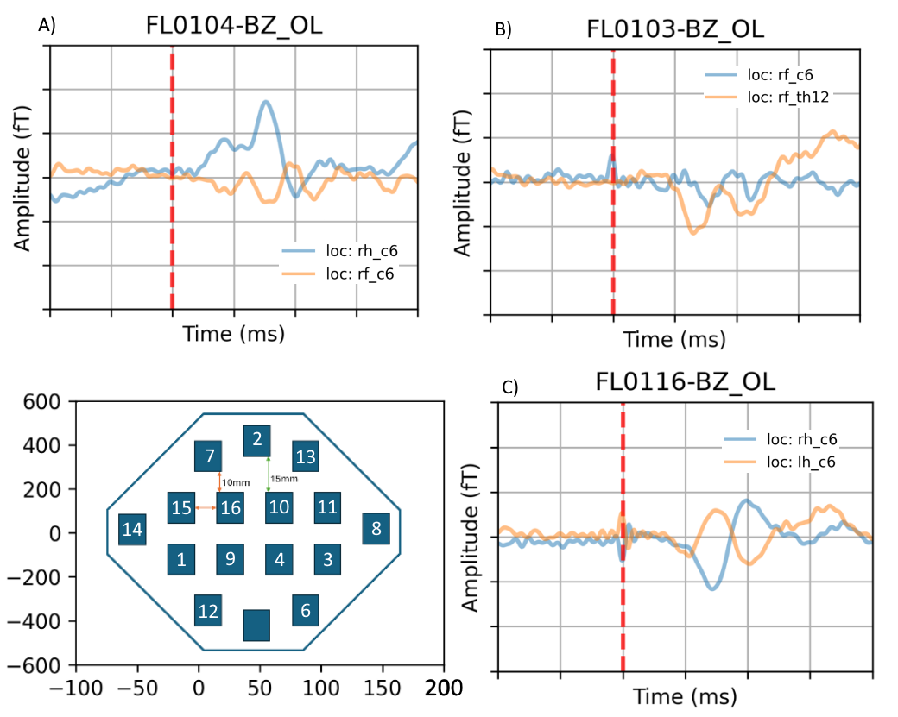
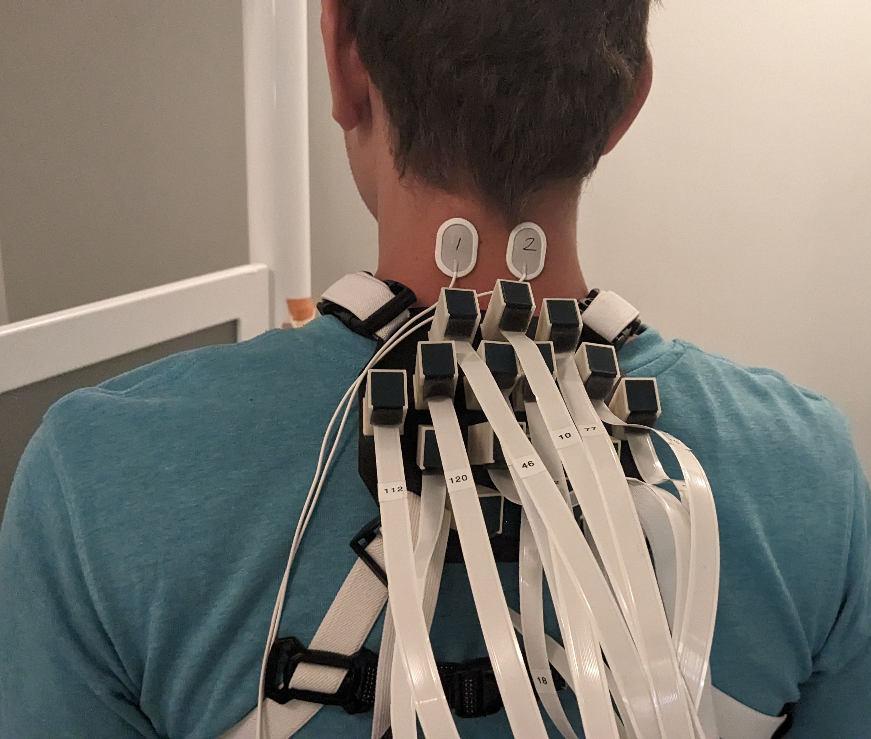
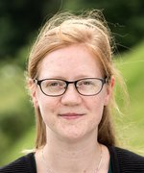
OPM Magnetospinography
Our very fresh pilot aiming to replicate Mardell et al.
Jacob Væver Andersen
Prof. Francesca Fardo

Slide 13
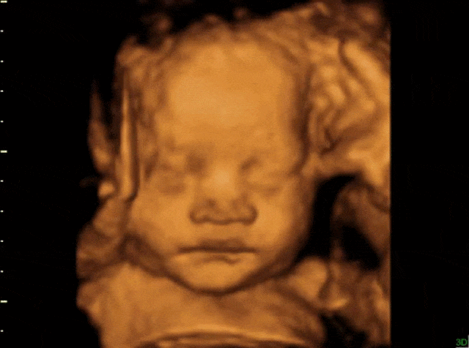
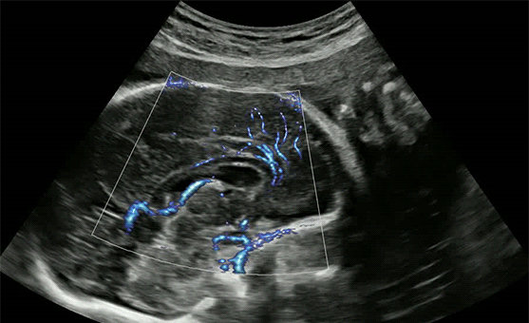
Fetal Brain Monitoring
Ultrasound dominates monitoring of pregnancy and fetal development
Ultrasound of fetal brain: structure and cerebral blood flow
Fetal brain function goes entirely unmonitored!
Development of brain function largely unvalidated in humans
No way to assess brain function in high-risk pregnancies or during pharmacological treatment
Presently only 2 labs in the world, but fetal MEG is a thing!

Slide 14
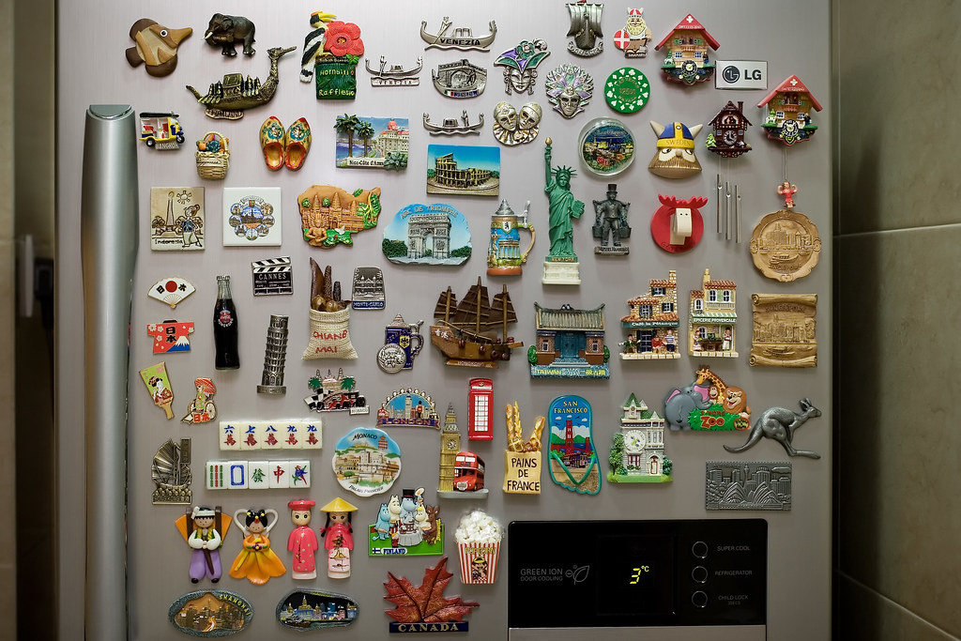


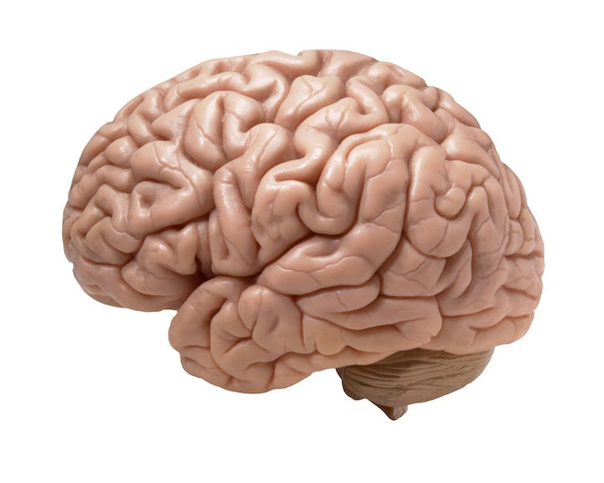
Scale of Magnetic Fields
Fridge magnet
~10 000 000 nT
Earth
~30 000 nT
Adult heart
0.08 nT
Adult brain
~0.0001 nT
Fetal brain
~0.00001 nT

Slide 15
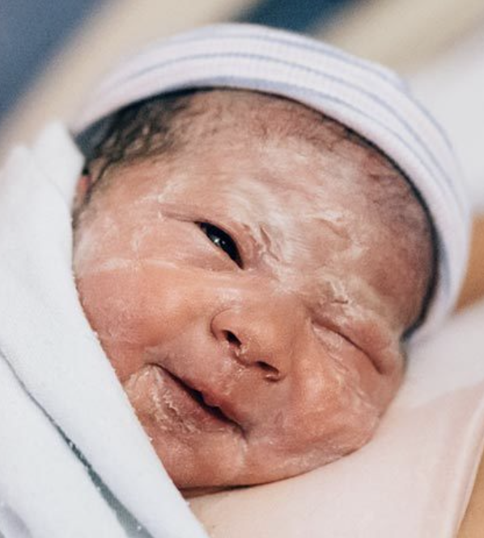
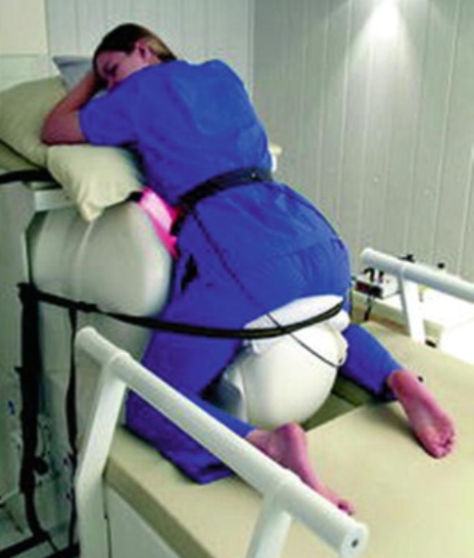
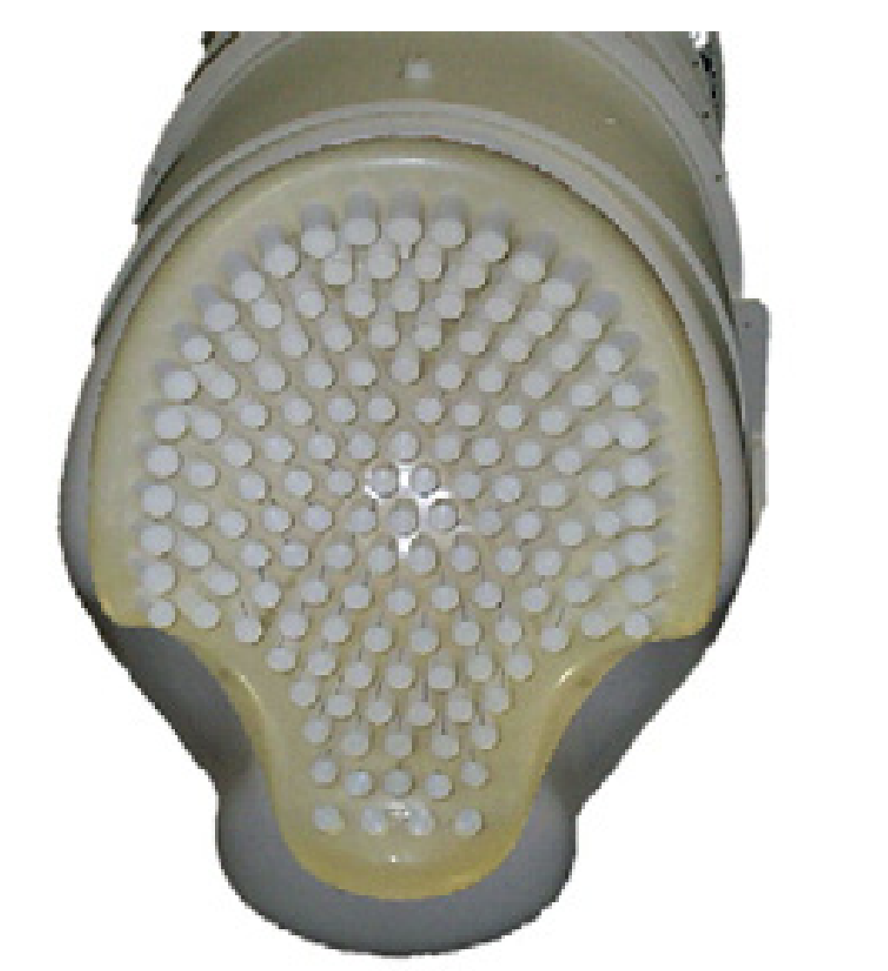


Fetal MEG with SQUIDs
Magnetometers should theoretically be a no-brainer:
Fetal ECG only possible until 3rd trimester;
fetal EEG considered too weak to be measured at all
Baby develops a waxy coating –
this blocks electrical signals but not magnetic!
Fetal MEG an order of magnitude smaller than adult MEG
Same SQUIDs but need a special shape to fit a pregnant abdomen
OPMs could provide a convenient and inexpensive alternative for fetal MCG and MEG
Eswaran et al. (2004)

Slide 16

A Little Heart
OPM ~5 pT
SQUID ~1 pT
Strand et al. (2019)
Fetal MCG with OPMs has been well-demonstrated
SNR appears to be optimal with belly-down
Reported signal amplitudes inspired us to give it a go!

Slide 17


A Little Heart
Our compromise for now: mother laying on her side
16 FieldLine OPMs over abdomen
We have easily detected the fetal cardiogram in all our attempts (N=8 to date, weeks 33-36)
6
150 bpm
Fetal MCG
4
2
Magnetic Field (pT)
0
-2
85 bpm
Maternal MCG
-4
-6
0.5
1
1.5
2
2.5
3
3.5
4
Time (s)

Slide 18
First, a little heart ❤️
2
0
-2
1000
1000.5
1001
1001.5
1002
1002.5
1003
1003.5
1004
1004.5
1005
2
1005
0
-2
1000
1000.5
1001
1001.5
1002
1002.5
1003
1003.5
1004
1004.5
1005
2
1005
Amplitude (pT)
0
-2
ICA
1000
1000.5
1001
1001.5
1002
1002.5
1003
1003.5
1004
1004.5
1005
Time (s)
1005
0.6
0.6
Maternal cardiogram (94 bpm)
0.4
0.4
0.2
0.2
0
0
-0.2
-0.2
1000
1000.5
1001
1001.5
1002
1002.5
1003
1003.5
1004
1004.5
1005
0.6
0.6
Fetal cardiogram (139 bpm)
0.4
0.4
Amplitude (pT)
0.2
0.2
0
0
-0.2
-0.2
1000
1000.5
1001
1001.5
1002
1002.5
1003
1003.5
1004
1004.5
1005
Time (s)
Maternal and fetal heartbeats are easily separable with ICA
Fetal MEG signals are typically ~20-60 fT – within reach of OPMs?

Slide 19


How about a little vision?
Example of SQUID-based fetal VER
(Eswaran et al., 2004)

Slide 20





Fetal Visual Evoked Response!
150 ms white light flashes (600 trials)
Example of SQUID-based fetal VER
(Eswaran et al., 2004)
Mother #1
Week 36
2 ms red light flashes (1200 trials)
Mother #2
Week 36

Slide 21

Fetal Visual Evoked Response!
Rearranged for ease of setup and
to allow more light to reach belly
3 covered grids of 5-6 OPMs

Slide 22


Fetal Visual Evoked Response!
2 ms red light flashes (1200 trials)
Fetal Visual Evoked Response
—— Average of true flashes
---- Average of rest condition
Topography after removal of cardiac components
Mother #5,
Week 37 of pregnancy
Head downwards

Slide 23


A way forward: ultrasound and fetal MEG
Fetal ultrasound imaging now has the quality for MRI-style segmentations
Baby’s head position and structure are the ingredients needed to do fetal MEG brain mapping!
Ana Namburete
Oxford Uni

Slide 24



Outlook
OPMs free MEG from its previous limitations
Expand MEG beyond the adult brain
More comfortable measurements of the retina and spinal cord
May bring fetal MEG to many more labs and hospitals

Slide 25



OptiMUM
Optically-pumped Magnetometry for
in Utero Measurement of developing brain function
Lars Henning Andersen, MD, PhD
Aarhus Uni Hospital
Prof. Ana Namburete
Oxford University
Prof. Hubert Preissl
University of Tübingen
PhD and postdoc positions available from winter for fetal OPM-MEG
cfin.au.dk/nemo
sarang@cfin.au.dk
@sarangnemo.bsky.social

Slide 26



Thanks!
Lars H. Pedersen
Obstetrics
Britta Westner
(now Donders Institute)
Jamie Lubell
CFIN-NEMOlab
Jacob Andersen
CFIN-NEMOlab
Svenja Knappe
Tyler Maydew
Orang Alem
Jeramy Hughes
Rasmus Zetter
cfin.au.dk/nemo
sarang@cfin.au.dk
@sarangnemo.bsky.social

